Slide 1
Mathematics for AI

Slide 2
Course Schedule
week.1
week.2 ~ 3
week.4 ~ 5
week. 6 ~ 7
week.8 - 9
week.10 ~ 11
week.12 ~ 13
Week.14 ~ 15
Course introduction
Vector
When Models Meet Data
Linear Algebra
Linear Algebra
(vector space, rank)
Analytic Geometry
Matrix Decomposition
Mid-term examination
“Mathematics for Machine Learning“ Marc Peter Deisenroth
Vector Calculus
Probability and Distribution
Continuous Optimization
Linear regression
Dimensionality Reduction with PCA
Density Estimation with GMM
Classification with SVM
Project Presentation
Final examination
Class: Mon. 9am ~ 12pm
Office Hour: Mon afternoon @231, W19, or over kakaotalk (010-6799-6636)

Slide 3
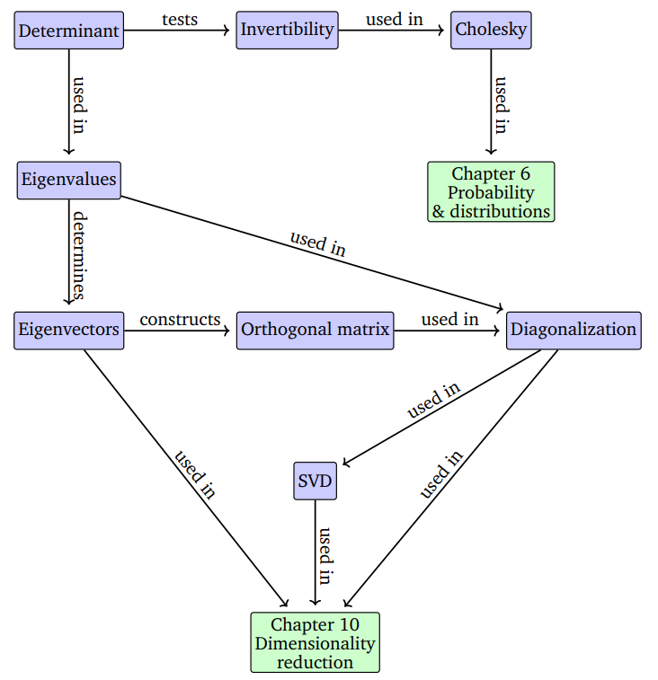
A mind map of the concepts of linear algebra
Source: Mathematics for Machine Learning, by Marc Peter Deisenroth, A. Aldo Faisal, Cheng Soon Ong

Slide 4
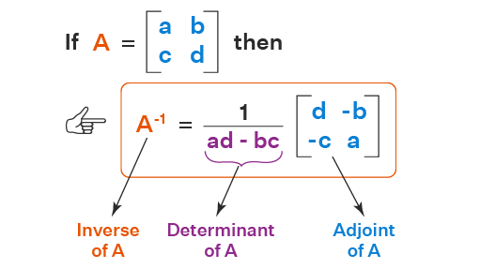
Determinant – 2 X 2 Matrix
A matrix is invertible when the determinant of it is not 0.
Source: https://www.cuemath.com/algebra/inverse-of-2x2-matrix/

Slide 5
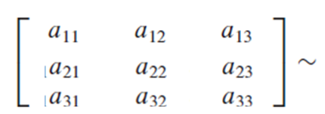
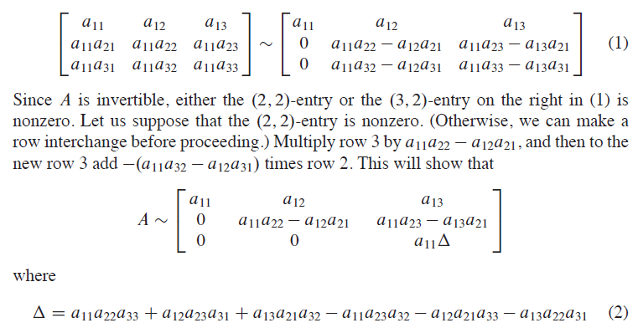
Determinant – 3 X 3 Matrix
We can discover the definition for the 3 x 3 case by watching what happens when an invertible 3 x 3 matrix A is row reduced.
Source: Linear Algebra and its applications by David C. Lay, Steven R. Lay, Judi J. McDonald, Pearson, Fifth Edition

Slide 6
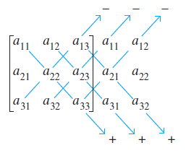
Determinant – Sarrus method
The expansion of a 3 x 3 determinant can be remembered by the following device. Write a second copy of the first two columns to the right of the matrix, and compute the determinant by multiplying entries on six diagonals:
Source: Linear Algebra and its applications by David C. Lay, Steven R. Lay, Judi J. McDonald, Pearson, Fifth Edition

Slide 7

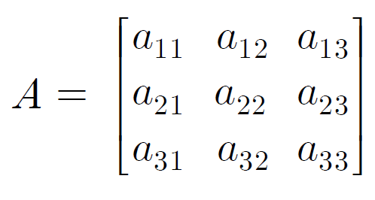
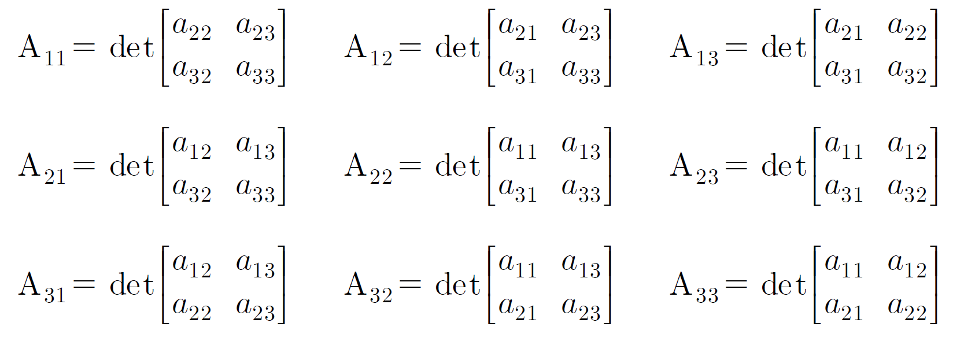
Determinant – 3 X 3 Matrix
Source: Linear Algebra and its applications by David C. Lay, Steven R. Lay, Judi J. McDonald, Pearson, Fifth Edition

Slide 8
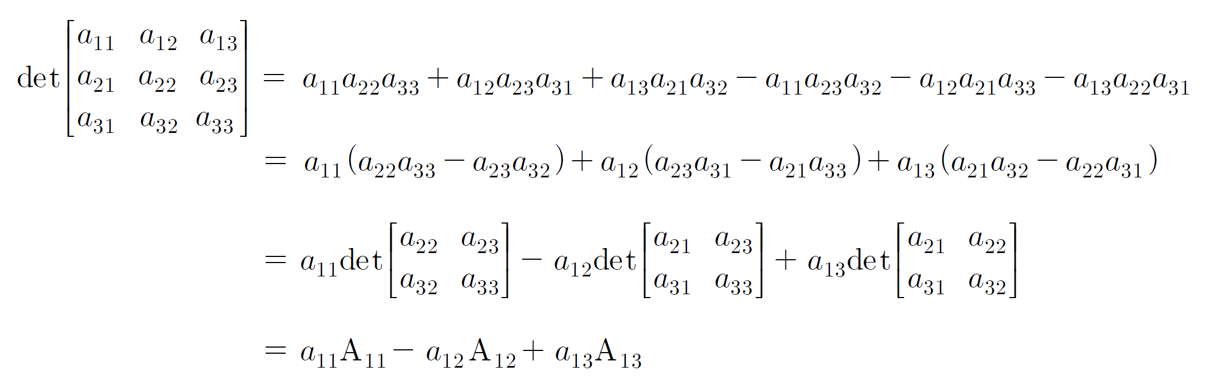
Determinant – 3 X 3 Matrix
Source: Linear Algebra and its applications by David C. Lay, Steven R. Lay, Judi J. McDonald, Pearson, Fifth Edition

Slide 9
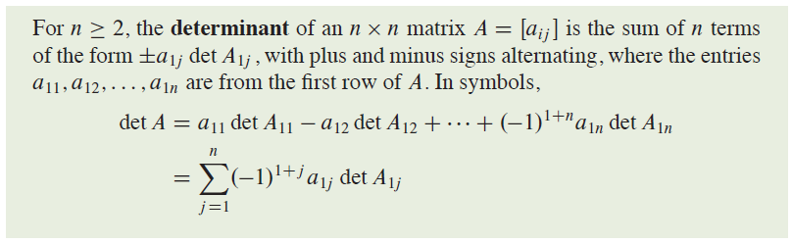
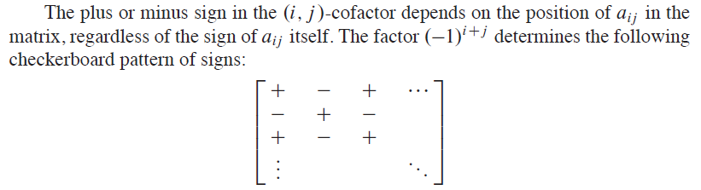
Determinant – Laplace expansion
Source: Linear Algebra and its applications by David C. Lay, Steven R. Lay, Judi J. McDonald, Pearson, Fifth Edition

Slide 10
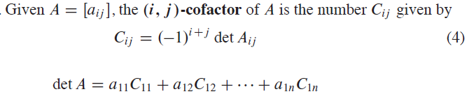
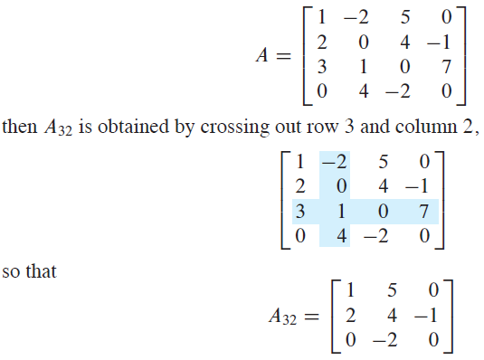
Determinant – Laplace Expansion
Source: Linear Algebra and its applications by David C. Lay, Steven R. Lay, Judi J. McDonald, Pearson, Fifth Edition

Slide 11
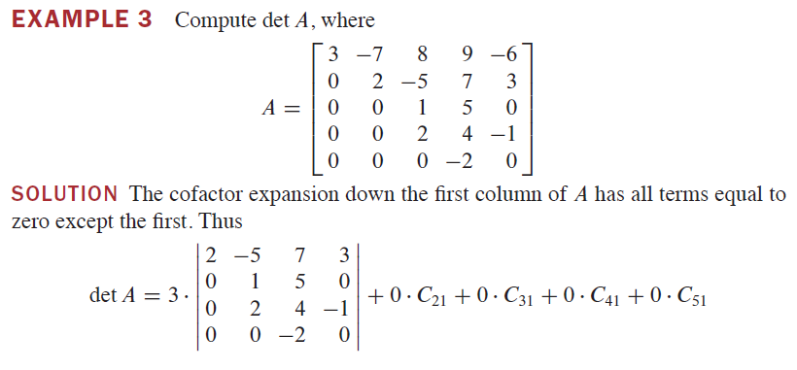
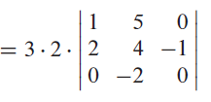
Determinant – Example
Source: Linear Algebra and its applications by David C. Lay, Steven R. Lay, Judi J. McDonald, Pearson, Fifth Edition

Slide 12
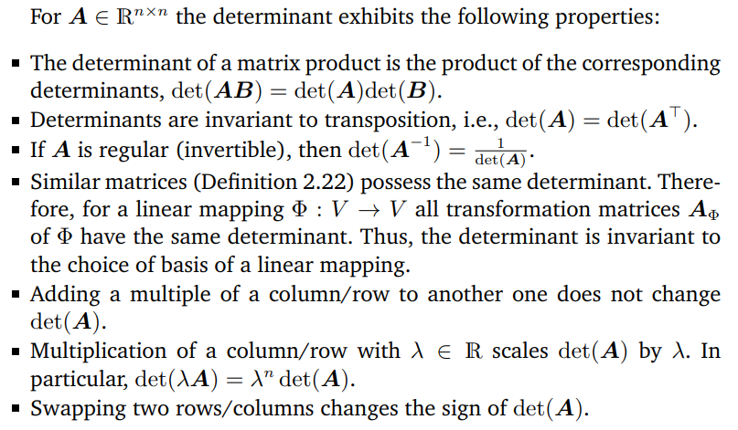
Determinant – Properties
Source: Mathematics for Machine Learning, by Marc Peter Deisenroth, A. Aldo Faisal, Cheng Soon Ong

Slide 13
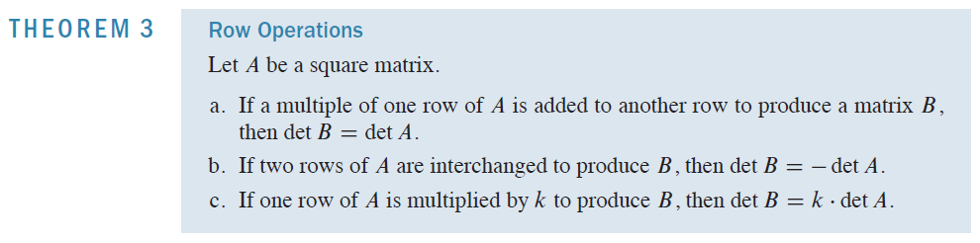
Determinant – Row Operation
Source: Linear Algebra and its applications by David C. Lay, Steven R. Lay, Judi J. McDonald, Pearson, Fifth Edition

Slide 14
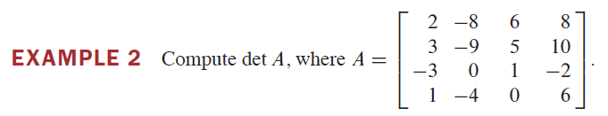
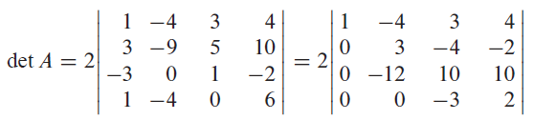
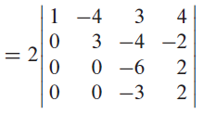
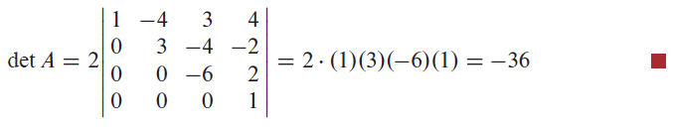
Determinant – Row Operation Example
Source: Linear Algebra and its applications by David C. Lay, Steven R. Lay, Judi J. McDonald, Pearson, Fifth Edition

Slide 15
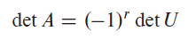
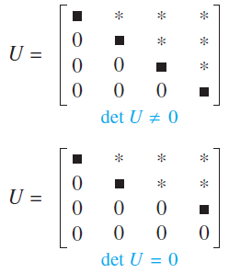
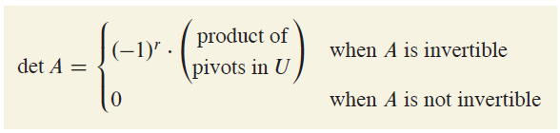
Determinant – Row Operation Example
Suppose a square matrix A has been reduced to an echelon form U by row replacements and row interchanges. If there are r interchanges, then
Source: Linear Algebra and its applications by David C. Lay, Steven R. Lay, Judi J. McDonald, Pearson, Fifth Edition

Slide 16
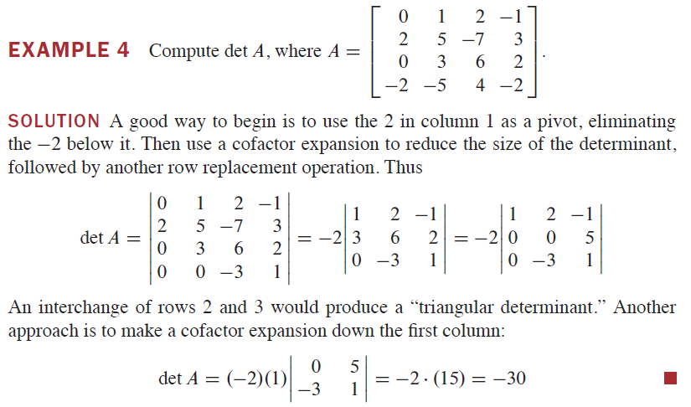
Determinant – Example
Source: Linear Algebra and its applications by David C. Lay, Steven R. Lay, Judi J. McDonald, Pearson, Fifth Edition

Slide 17
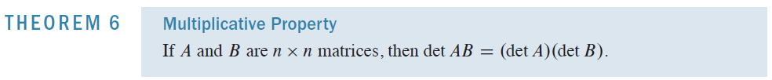
Properties of Determinant
Source: Linear Algebra and its applications by David C. Lay, Steven R. Lay, Judi J. McDonald, Pearson, Fifth Edition

Slide 18
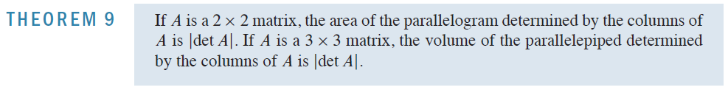
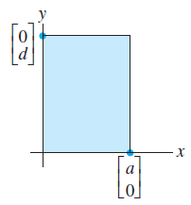
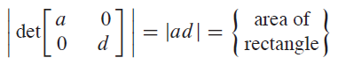
Determinants as Area or Volume
Diagonal matrix case
Source: Linear Algebra and its applications by David C. Lay, Steven R. Lay, Judi J. McDonald, Pearson, Fifth Edition

Slide 19
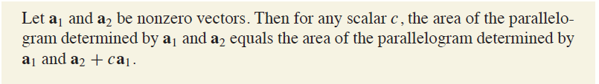
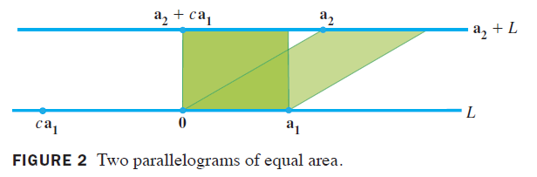
Determinants as Area or Volume
Area remain same over the row operations
Source: Linear Algebra and its applications by David C. Lay, Steven R. Lay, Judi J. McDonald, Pearson, Fifth Edition

Slide 20
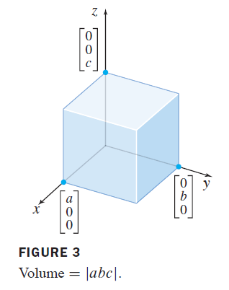
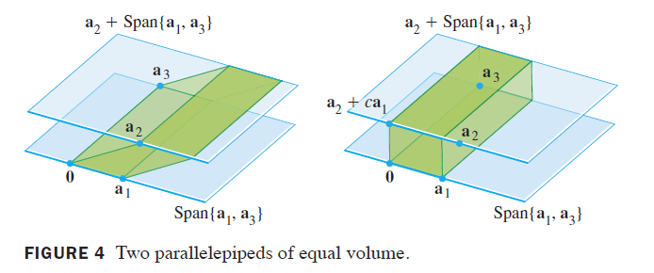
Determinants as Area or Volume
Diagonal matrix case
Volume remain same over the row operations
Source: Linear Algebra and its applications by David C. Lay, Steven R. Lay, Judi J. McDonald, Pearson, Fifth Edition

Slide 21
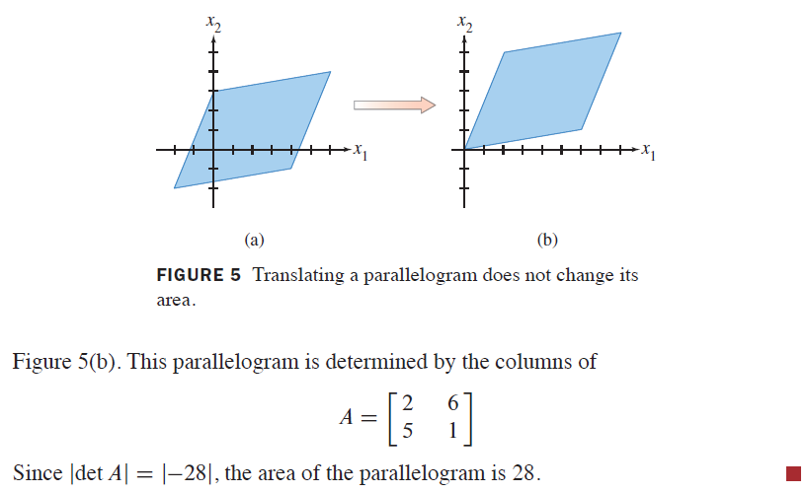
Determinants as Area or Volume
Source: Linear Algebra and its applications by David C. Lay, Steven R. Lay, Judi J. McDonald, Pearson, Fifth Edition

Slide 22
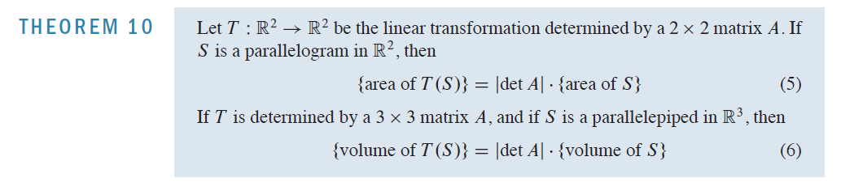
Determinants as Area or Volume
Source: Linear Algebra and its applications by David C. Lay, Steven R. Lay, Judi J. McDonald, Pearson, Fifth Edition

Slide 23
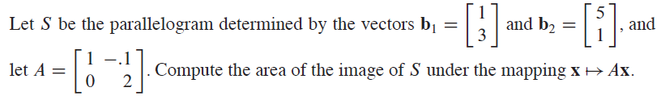
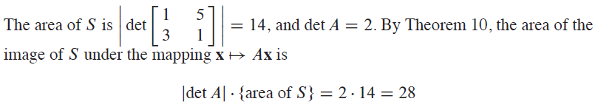
Determinants as Area or Volume
Source: Linear Algebra and its applications by David C. Lay, Steven R. Lay, Judi J. McDonald, Pearson, Fifth Edition

Slide 24
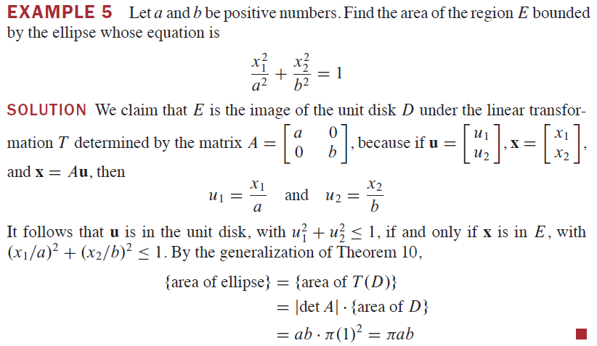
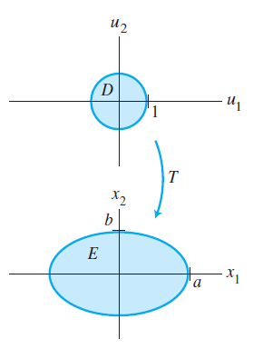
Determinants as Area or Volume
Source: Linear Algebra and its applications by David C. Lay, Steven R. Lay, Judi J. McDonald, Pearson, Fifth Edition

Slide 25
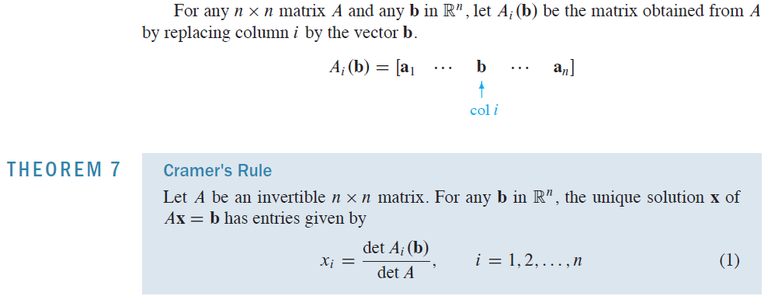
Cramer’s Rule
Source: Linear Algebra and its applications by David C. Lay, Steven R. Lay, Judi J. McDonald, Pearson, Fifth Edition

Slide 26
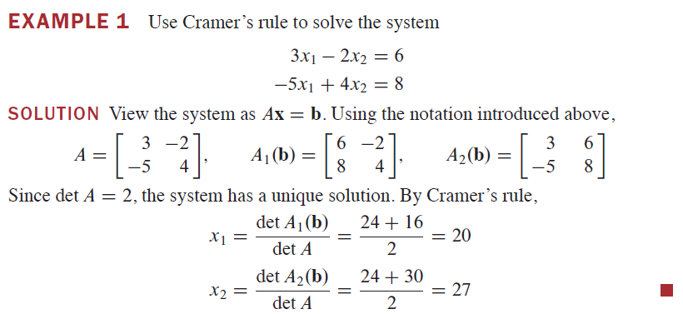
Cramer’s Rule
Source: Linear Algebra and its applications by David C. Lay, Steven R. Lay, Judi J. McDonald, Pearson, Fifth Edition

Slide 27
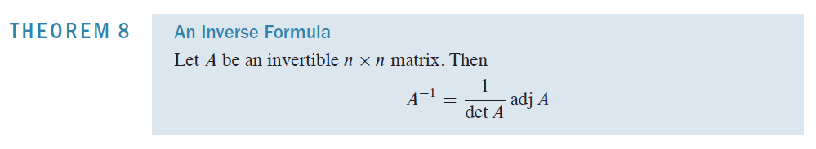
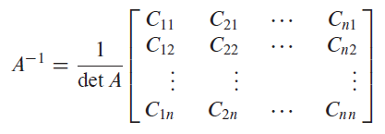
Cramer’s Rule
Application of Cramer’s Rule is useful mainly for theoretical calculations, and it is inefficient in real calculation compared to the row operation method.
Source: Linear Algebra and its applications by David C. Lay, Steven R. Lay, Judi J. McDonald, Pearson, Fifth Edition

Slide 28
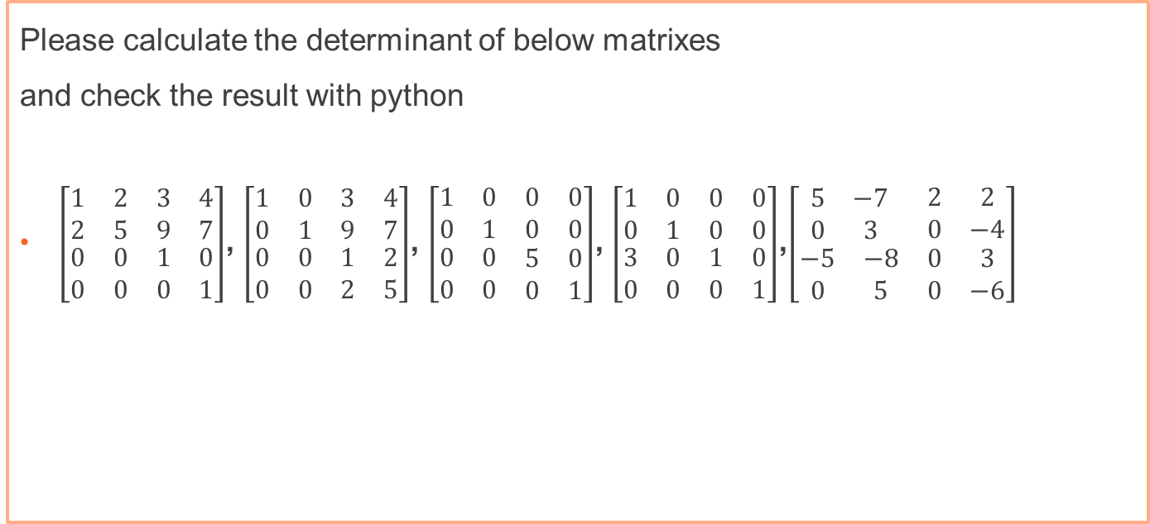
Exercise 1 – Determinant
Please calculate the determinant of below matrixes
and check the result with python
$\left[\begin{matrix}\begin{matrix}1 & 2 \\ 2 & 5\end{matrix} & \begin{matrix}3 & 4 \\ 9 & 7\end{matrix} \\ \begin{matrix}0 & 0 \\ 0 & 0\end{matrix} & \begin{matrix}1 & 0 \\ 0 & 1\end{matrix}\end{matrix}\right]$, $\left[\begin{matrix}\begin{matrix}1 & 0 \\ 0 & 1\end{matrix} & \begin{matrix}3 & 4 \\ 9 & 7\end{matrix} \\ \begin{matrix}0 & 0 \\ 0 & 0\end{matrix} & \begin{matrix}1 & 2 \\ 2 & 5\end{matrix}\end{matrix}\right]$, $\left[\begin{matrix}\begin{matrix}1 & 0 \\ 0 & 1\end{matrix} & \begin{matrix}0 & 0 \\ 0 & 0\end{matrix} \\ \begin{matrix}0 & 0 \\ 0 & 0\end{matrix} & \begin{matrix}5 & 0 \\ 0 & 1\end{matrix}\end{matrix}\right]$, $\left[\begin{matrix}\begin{matrix}1 & 0 \\ 0 & 1\end{matrix} & \begin{matrix}0 & 0 \\ 0 & 0\end{matrix} \\ \begin{matrix}3 & 0 \\ 0 & 0\end{matrix} & \begin{matrix}1 & 0 \\ 0 & 1\end{matrix}\end{matrix}\right]$,$\left[\begin{matrix}\begin{matrix}5 & −7 \\ 0 & 3\end{matrix} & \begin{matrix}2 & 2 \\ 0 & −4\end{matrix} \\ \begin{matrix}−5 & −8 \\ 0 & 5\end{matrix} & \begin{matrix}0 & 3 \\ 0 & −6\end{matrix}\end{matrix}\right]$

Slide 29
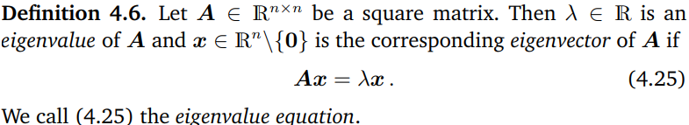
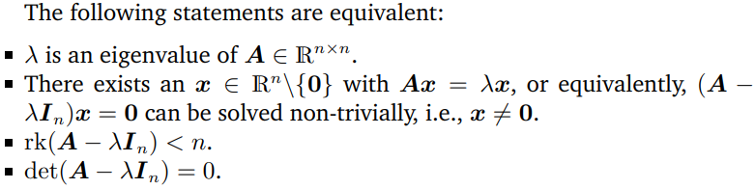
Eigenvector and Eigenvalue
Source: Mathematics for Machine Learning, by Marc Peter Deisenroth, A. Aldo Faisal, Cheng Soon Ong

Slide 30
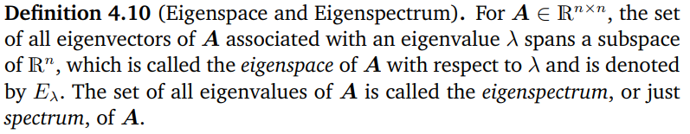
Eigenspace and Eigenspectrum
Source: Mathematics for Machine Learning, by Marc Peter Deisenroth, A. Aldo Faisal, Cheng Soon Ong

Slide 31
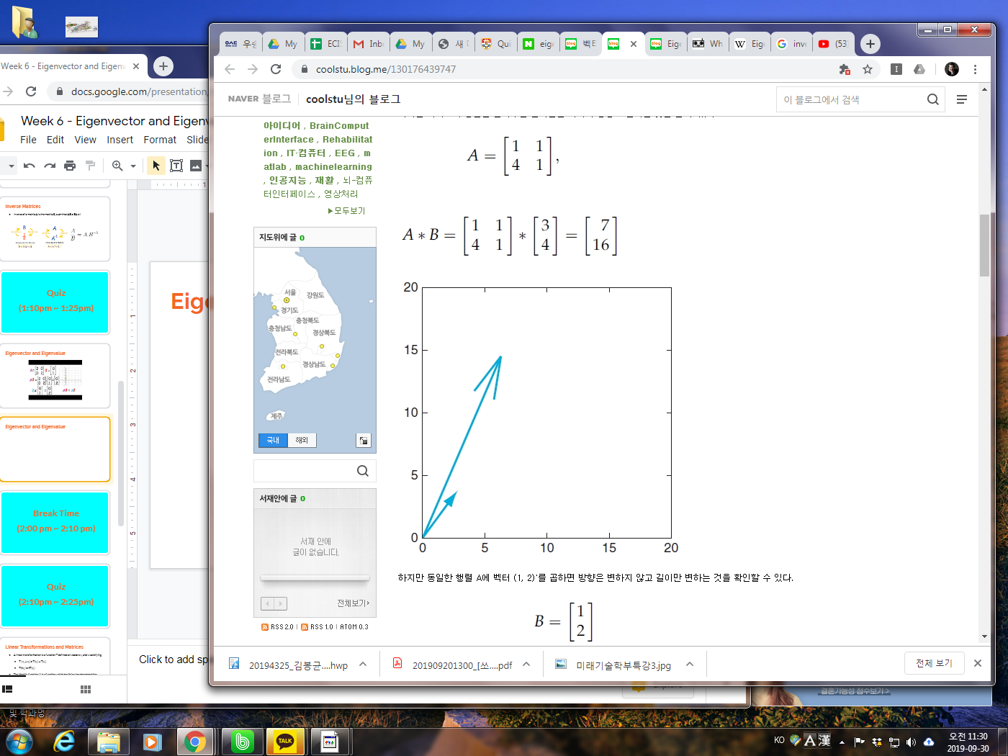
Eigenvector and Eigenvalue

Slide 32
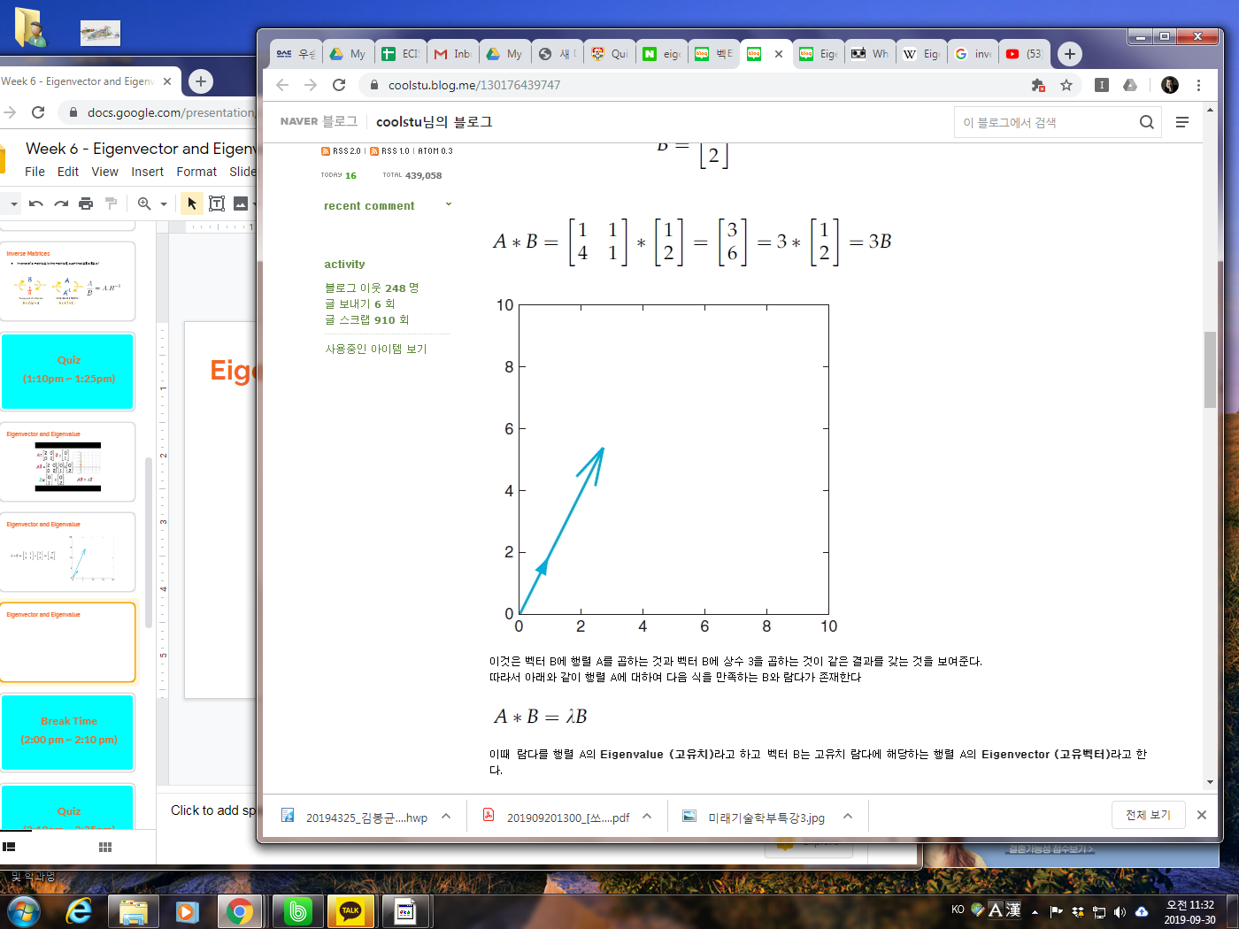
Eigenvector and Eigenvalue

Slide 33
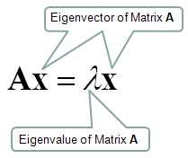
Eigenvector and Eigenvalue

Slide 34
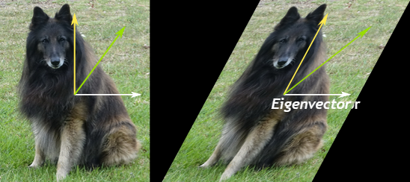
Eigenvector and Eigenvalue
Source: https://www.mathsisfun.com/algebra/eigenvalue.html/, 2021. 17th, May

Slide 35

Eigenvector and Eigenvalue
↔ Determinant of (A - λ I ) = 0

Slide 36

Eigenvector and Eigenvalue
Source: https://www.value-at-risk.net/, 2019. 30th, Sept.

Slide 37

Eigenvector and Eigenvalue
Source: https://www.value-at-risk.net/, 2019. 30th, Sept.

Slide 38

Eigenvector and Eigenvalue
Please find eigenvalues and eigenvectors of below matrix
$$\left(\begin{matrix}1 & 0 & −1 \\ 1 & 2 & 1 \\ 2 & 2 & 3\end{matrix}\right)$$

Slide 39


Exercise 2
Please find the eigenvalues & eigenvectors of below matrices
$\left(\begin{matrix}0 & 1 \\ −2 & −3\end{matrix}\right)$
$\left(\begin{matrix}1 & −1 \\ 2 & 4\end{matrix}\right)$
Please check the result by using python program
$\left(\begin{matrix}1 & 2 & 2 \\ 0 & 2 & 1 \\ −1 & 2 & 2\end{matrix}\right)$
$\left(\begin{matrix}1 & 0 & −1 \\ 1 & 2 & 1 \\ 2 & 2 & 3\end{matrix}\right)$

Slide 40



PageRank (페이지랭크)
Links between Webpages
(웹페이지간의 링크)
Transition Probability (M)
(전이확률 행렬)
Transition
(전이)
A
B
A
B
C
D
A
$$v_{1}=Mv_{0}$$
$$\left(\begin{matrix}\begin{matrix}0 & 1/2 \\ 1/3 & 0\end{matrix} & \begin{matrix}1/2 & 0 \\ 0 & 1\end{matrix} \\ \begin{matrix}1/3 & 0 \\ 1/3 & 1/2\end{matrix} & \begin{matrix}0 & 0 \\ 1/2 & 0\end{matrix}\end{matrix}\right)$$
B
C
$$v=Mv$$
C
D
D
Source:응용이보이는 선형대수학, 이건명지음, 한빛아카데미

Slide 41




PageRank
Links between Webpages
Transition Probability (M)
Eigenvector $v$
A
B
A
B
C
D
$$v=Mv$$
A
$$\left(\begin{matrix}\begin{matrix}0 & 1/2 \\ 1/3 & 0\end{matrix} & \begin{matrix}1/2 & 0 \\ 0 & 1\end{matrix} \\ \begin{matrix}1/3 & 0 \\ 1/3 & 1/2\end{matrix} & \begin{matrix}0 & 0 \\ 1/2 & 0\end{matrix}\end{matrix}\right)$$
B
$$v ≈ \left(\begin{matrix}\begin{matrix}0.23 \\ 0.38\end{matrix} \\ \begin{matrix}0.08 \\ 0.31\end{matrix}\end{matrix}\right)$$
C
C
D
D
Source:응용이보이는 선형대수학, 이건명지음, 한빛아카데미

Slide 42

PageRank
A
B
A
B
$$v_{t+1}=βMv_{t}+\frac{1−β}{n}e$$
C
D
C
D
E
Source:응용이보이는 선형대수학, 이건명지음, 한빛아카데미

Slide 43


Slide 44

Eigen Decomposition

Slide 45

Eigen Decomposition

Slide 46

Eigen Decomposition

Slide 47

Eigen Decomposition

Slide 48
Eigen Decomposition
$A^{k}= (VΛV^{−1})(VΛV^{−1})⋯$ $\left(VΛV^{−1}\right)=V{Λ^{k}V}^{−1}$

Slide 49

Exercise 3

Slide 50
BongGyun Kim
Office hour: Mon. 2pm ~ 6pm
@ room 231, building W19
Phone: 042-629-6636
Mobile: 010-6799-6636
bonggyun.kim@endicott.ac.kr

Slide 51
End of Week 7

